Slide 1
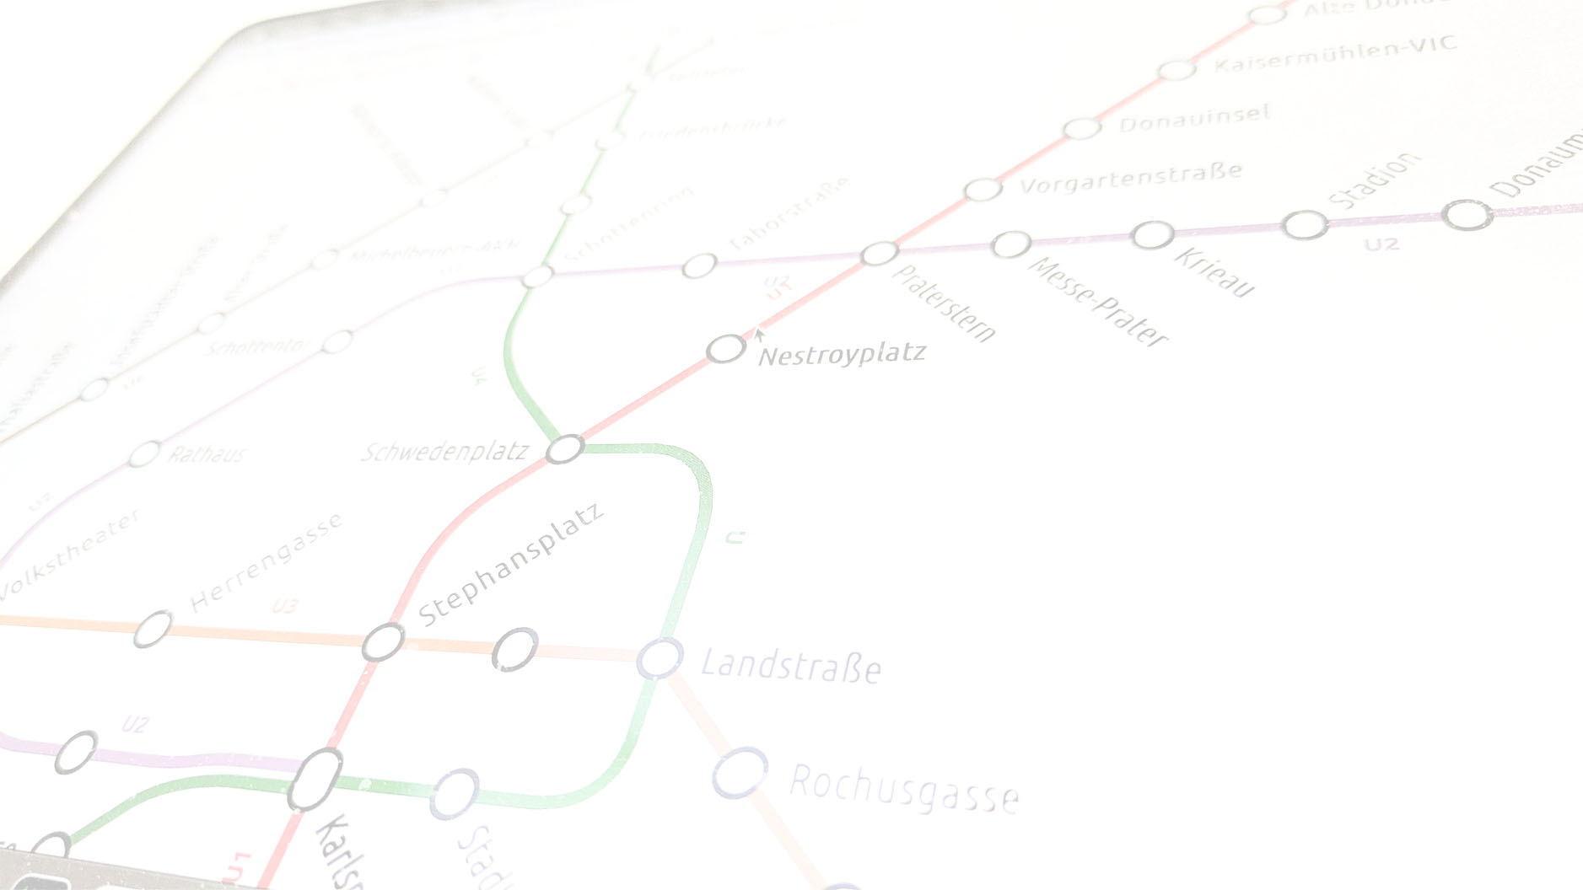

Disintegrating Automated Transit Map Design
An Algorithmic Core for Fast Layout Iteration
Soeren Terziadis
Thomas C. van Dijk
Notes:
This is the ALGA slide template.
You can pick a different logo variant by changing the title slide's layout (in Home > Slides > Layout).
Alternatively, you can change the title slide completely (e.g., to add another institute's logo) by using the Slide Master view.

Slide 2
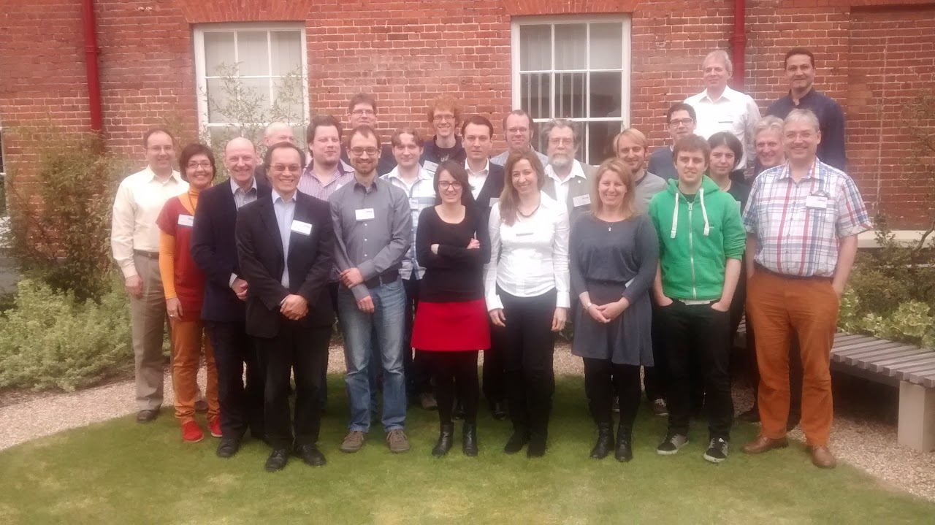
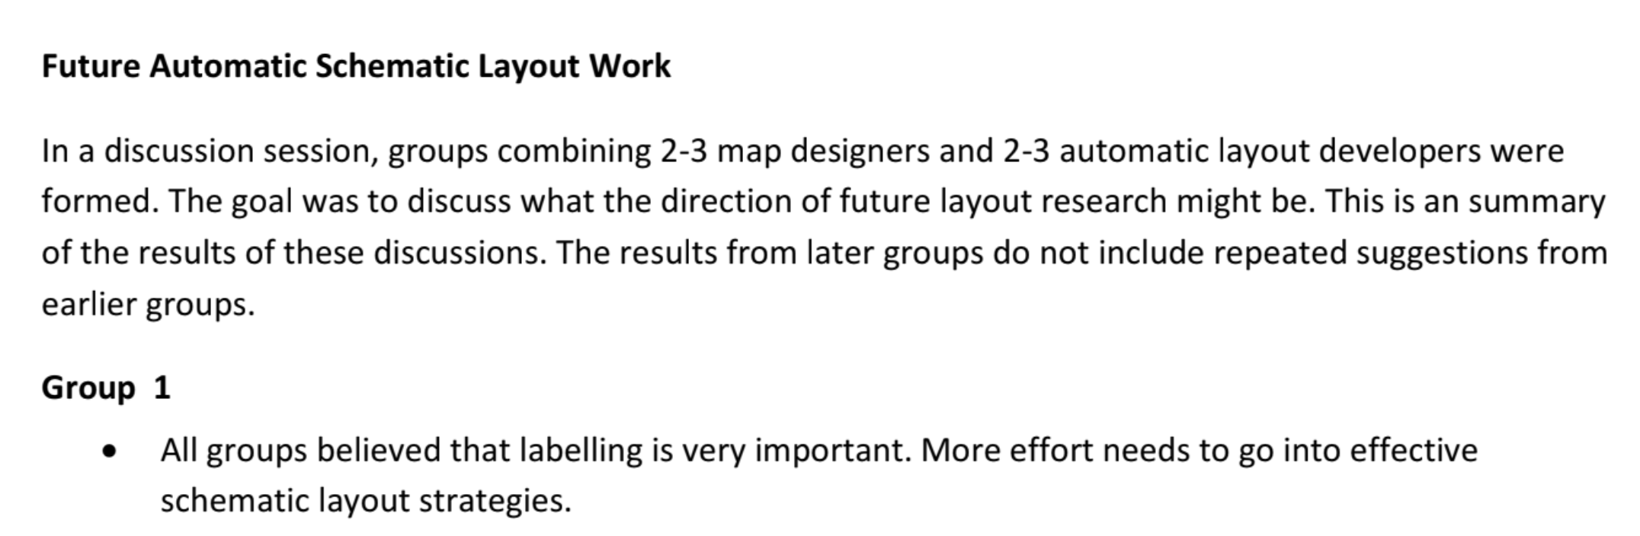
April 3rd 2014, Wivenhoe House Hotel, Colchester

Slide 3
April 3rd 2014, Wivenhoe House Hotel, Colchester

Slide 4
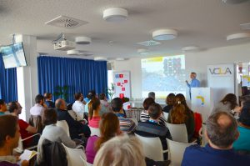
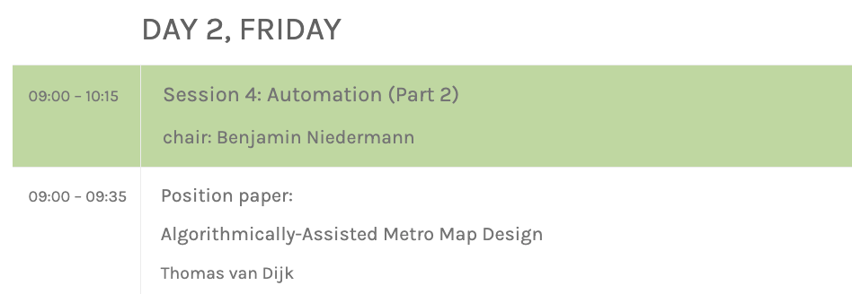
April 12th 2019, TU Wien Campus Grußhaus, Vienna

Slide 5
April 12th 2019, TU Wien Campus Grußhaus, Vienna

Slide 6
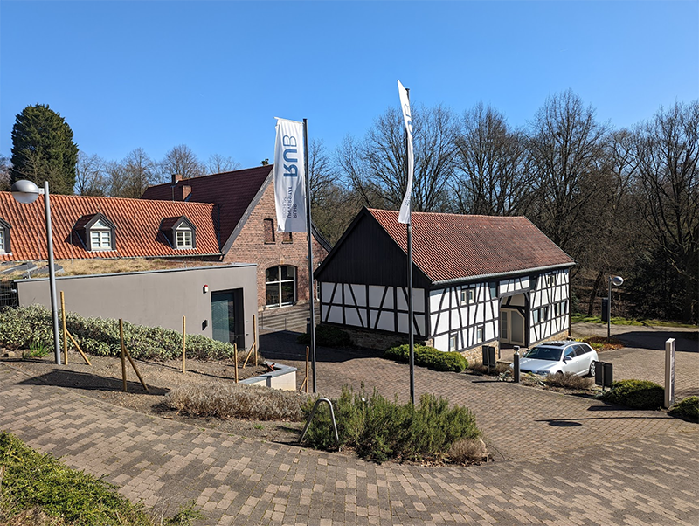
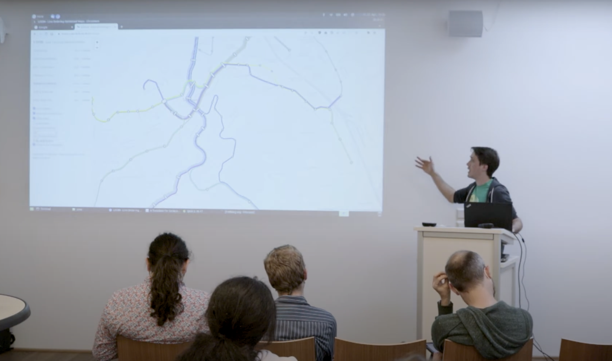
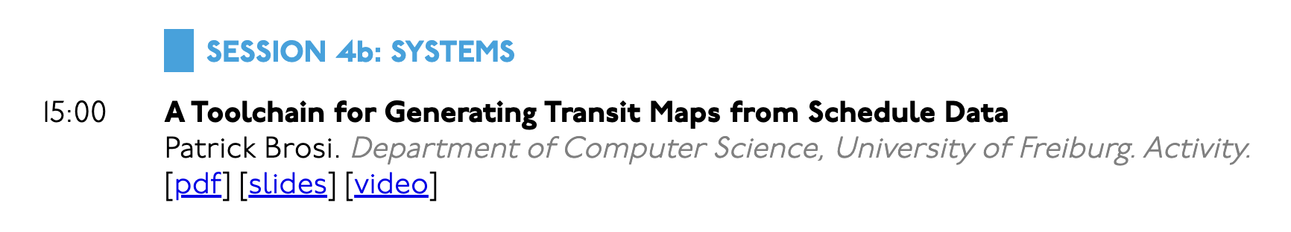
22nd April 2022, Beckmanns Hof, Bochum

Slide 7
22nd April 2022, Beckmanns Hof, Bochum

Slide 8
22nd April 2022, Beckmanns Hof, Bochum

Slide 9
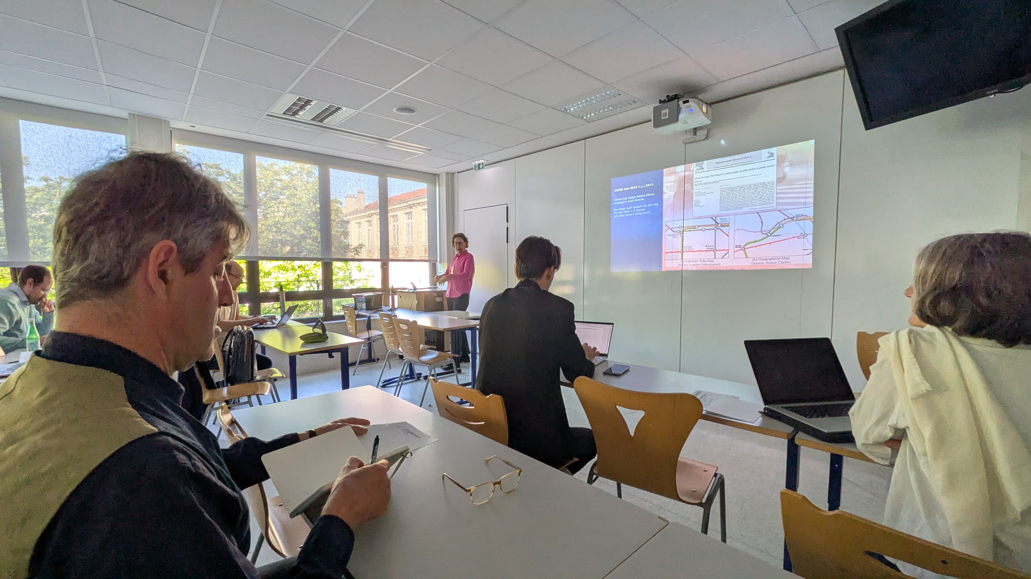
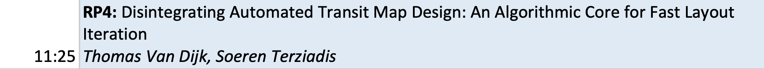
April 11th 2025, Ecole d'Ingénieurs de la Ville de Paris, Paris

Slide 10
April 11th 2025, Ecole d'Ingénieurs de la Ville de Paris, Paris

Slide 11
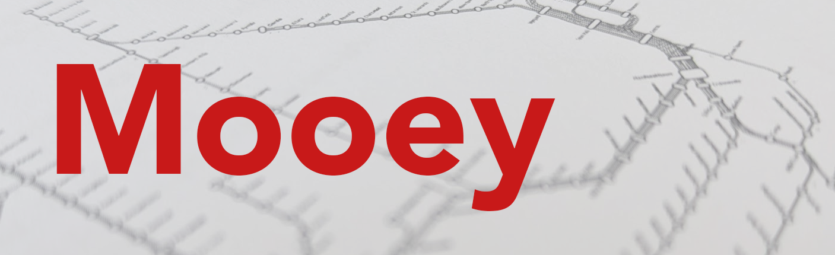
April 11th 2025, Ecole d'Ingénieurs de la Ville de Paris, Paris
https://github.com/tcvdijk/mooey
Demo
Some philosophical considerations
Maths for nerds

Slide 14
Some philosophical considerations
Allow the design to be in an inconsistent or invalid state
Allows fast, best-effort algorithms
Do not get in the user’s way (cf. database transactions)
Do not add stability measures to the optimisation
Our layout is a pure function of the design decisions, not the edit history or randomness
Clicking solve a second time should not do anything
Design is a search problem
Linear undo/redo is too limited
Merge drawings

Slide 15
Realisation
Where do the stations go?

Slide 16
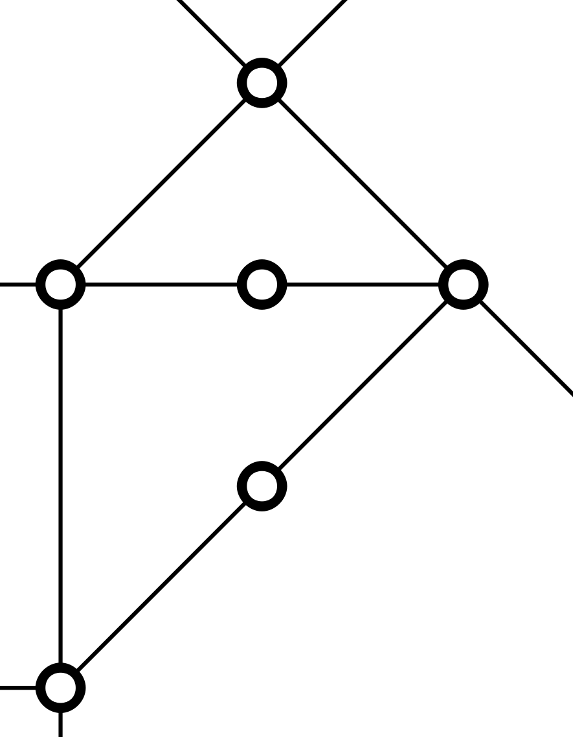



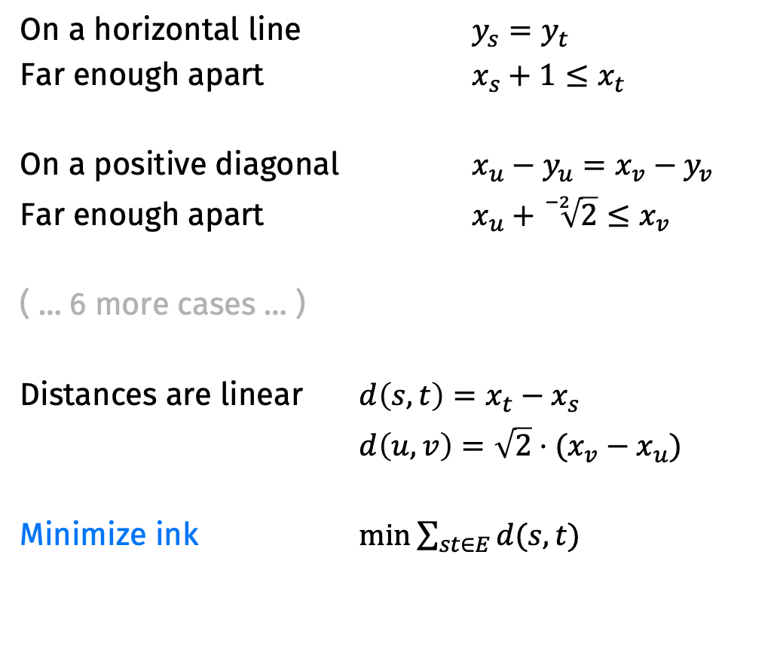

Realisation
On a horizontal line $y_{s}=y_{t}$
Far enough apart $x_{s}+1≤x_{t}$
On a positive diagonal $x_{u}−y_{u}=x_{v}−y_{v}$
Far enough apart $x_{u}+\sqrt[−2]{2}≤x_{v}$
( … 6 more cases … )
Distances are linear $d\left(s,t\right)=x_{t}−x_{s}$
$d\left(u,v\right)={\sqrt{2}⋅(x}_{v}−x_{u})$
Minimize ink $\min{\sum_{st∈E}{d(s,t)}}$
$$(x_{s},y_{s})$$
$$(x_{t},y_{t})$$
$$(x_{v},y_{v})$$
$$(x_{u},y_{u})$$

Slide 17





Spacing colinear stations
Many drawing algorithms contract degree-2 stations and put them back in postprocessing.
We do not need to, because we are fast.
Set $d\left(s,t\right)≤b_{σ}$ for a group of edges $σ$.
Minimize the $b_{σ}$.
$$≤b_{σ}$$
$$≤b_{σ}$$
$$≤b_{σ}$$
$$≤b_{σ}$$

Slide 18
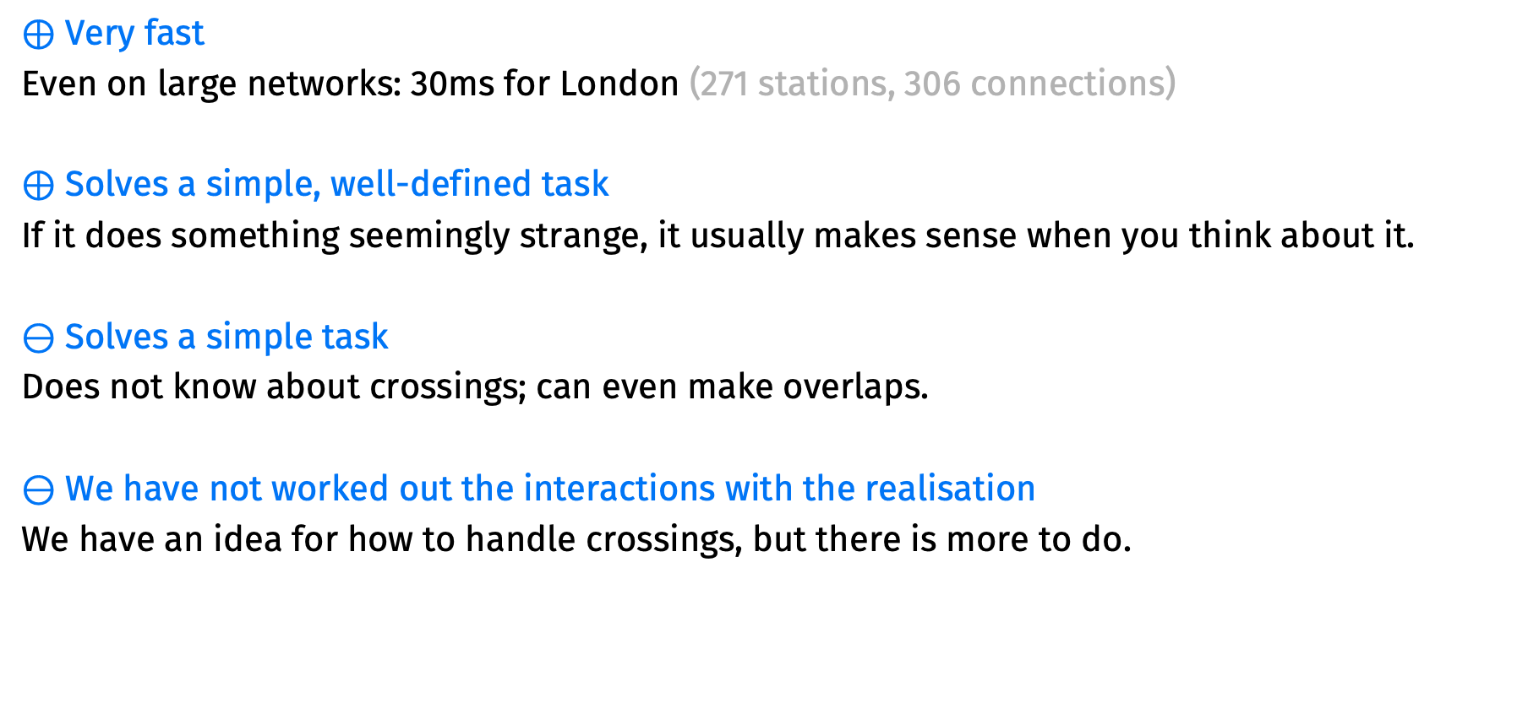
Pros & Cons
$⊕$ Very fast
Even on large networks: 30ms for London (271 stations, 306 connections)
$⊕$ Solves a simple, well-defined task
If it does something seemingly strange, it usually makes sense when you think about it.
$⊖$ Solves a simple task
Does not know about crossings; can even make overlaps.
$⊖$ We have not worked out the interactions with the realisation
We have an idea for how to handle crossings, but there is more to do.

Slide 19
Port Assignment
What directions do the connections have?

Slide 20
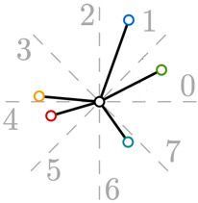
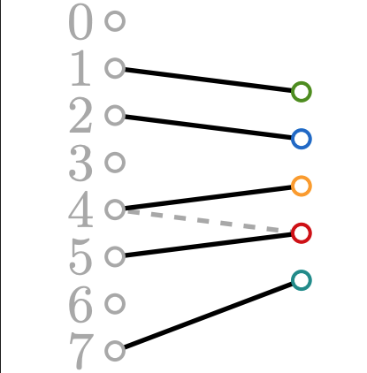
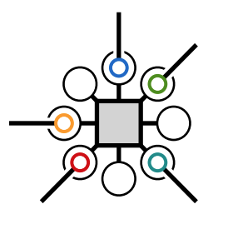
Fast methods
We have geographic bearings between the stations.
You might have track geography.
Assign ports based on angle error.

Slide 21
Inconsistent port assignment

Slide 22
Inconsistent port assignment

Slide 23
Inconsistent port assignment

Slide 24
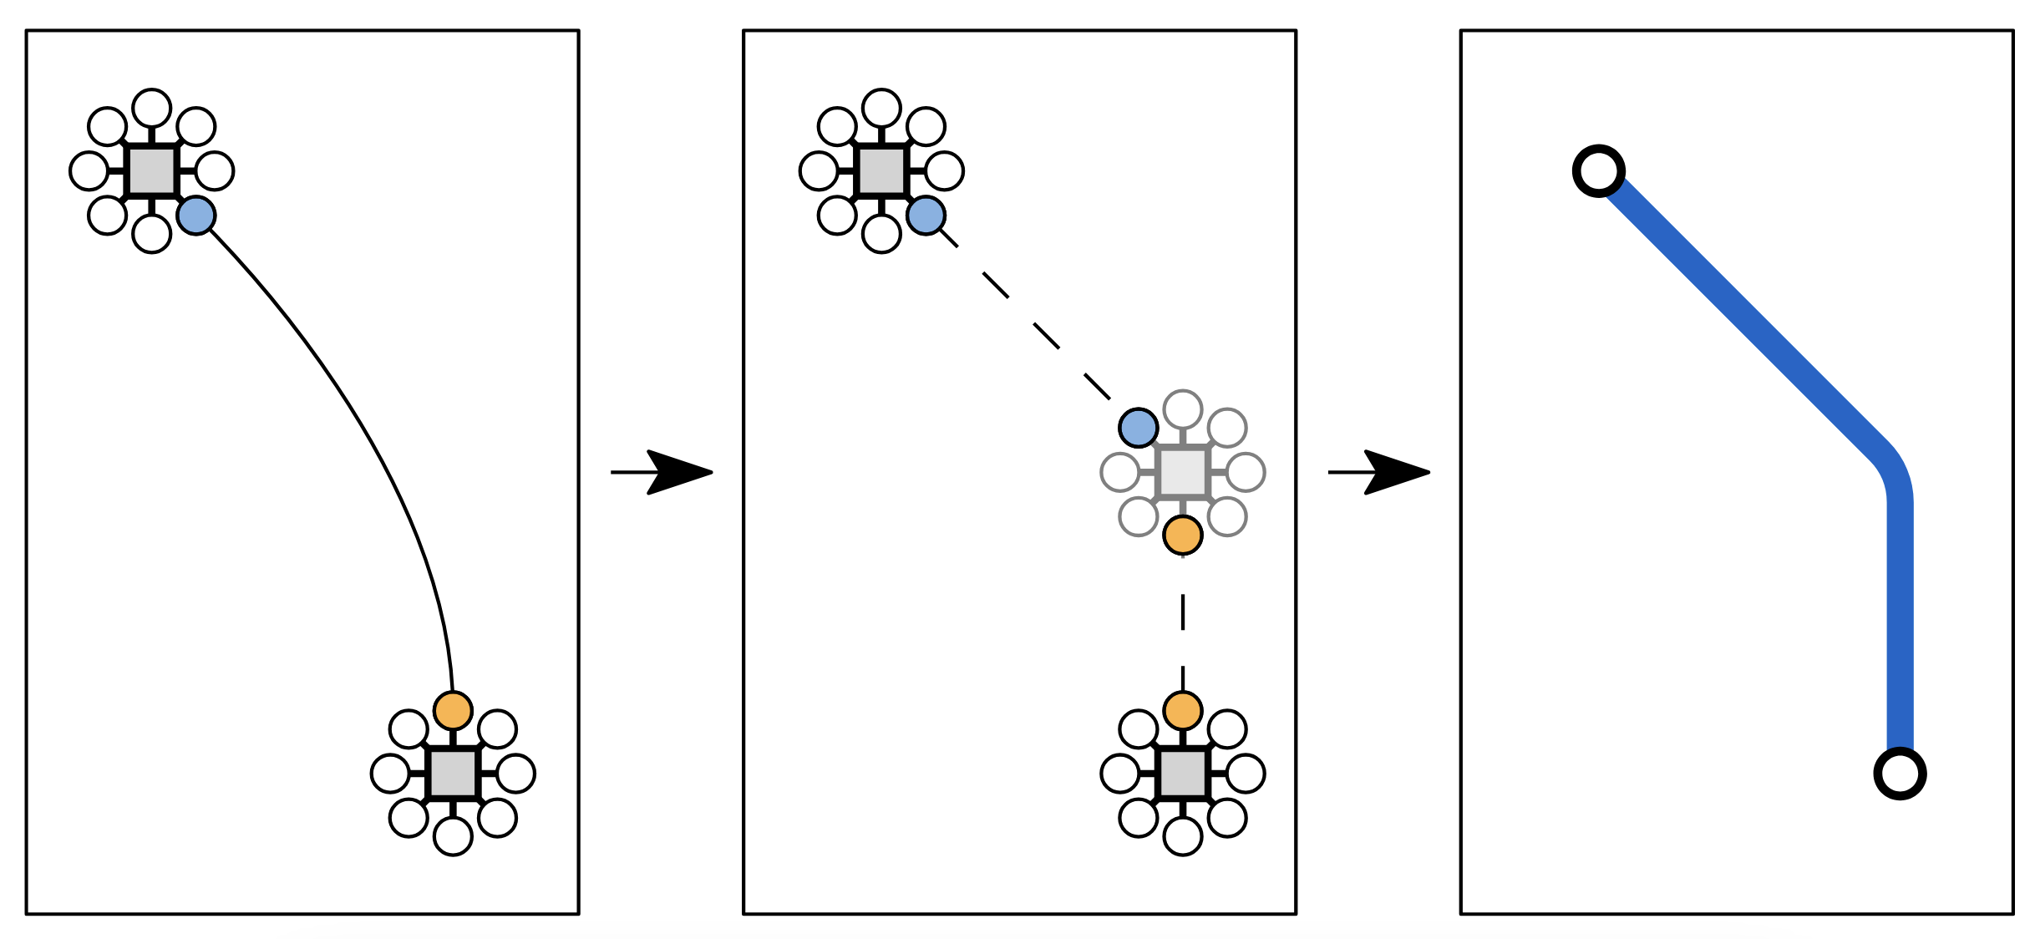
Inconsistent port assignment? Bend!

Slide 25
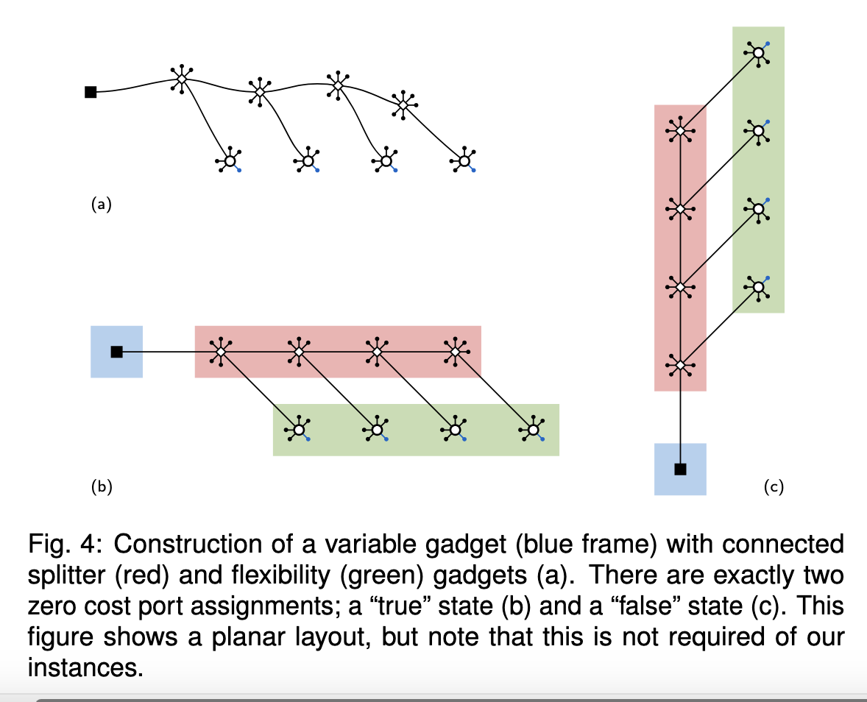
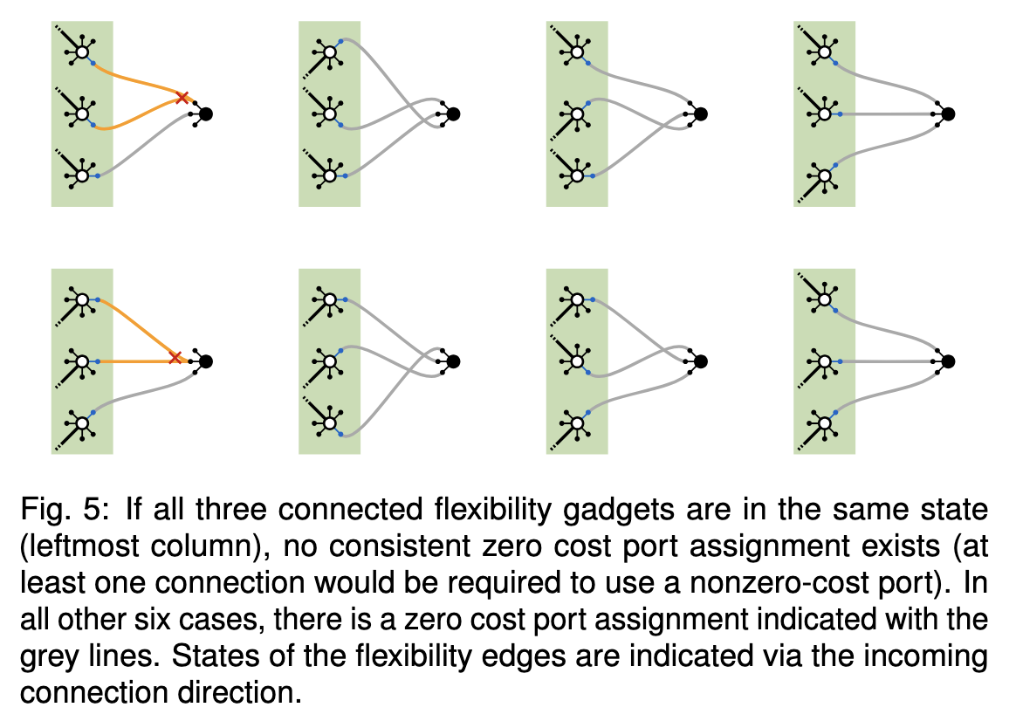
Consistent Port Assignment: NP-hard (PNAE-3SAT)

Slide 26
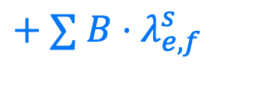
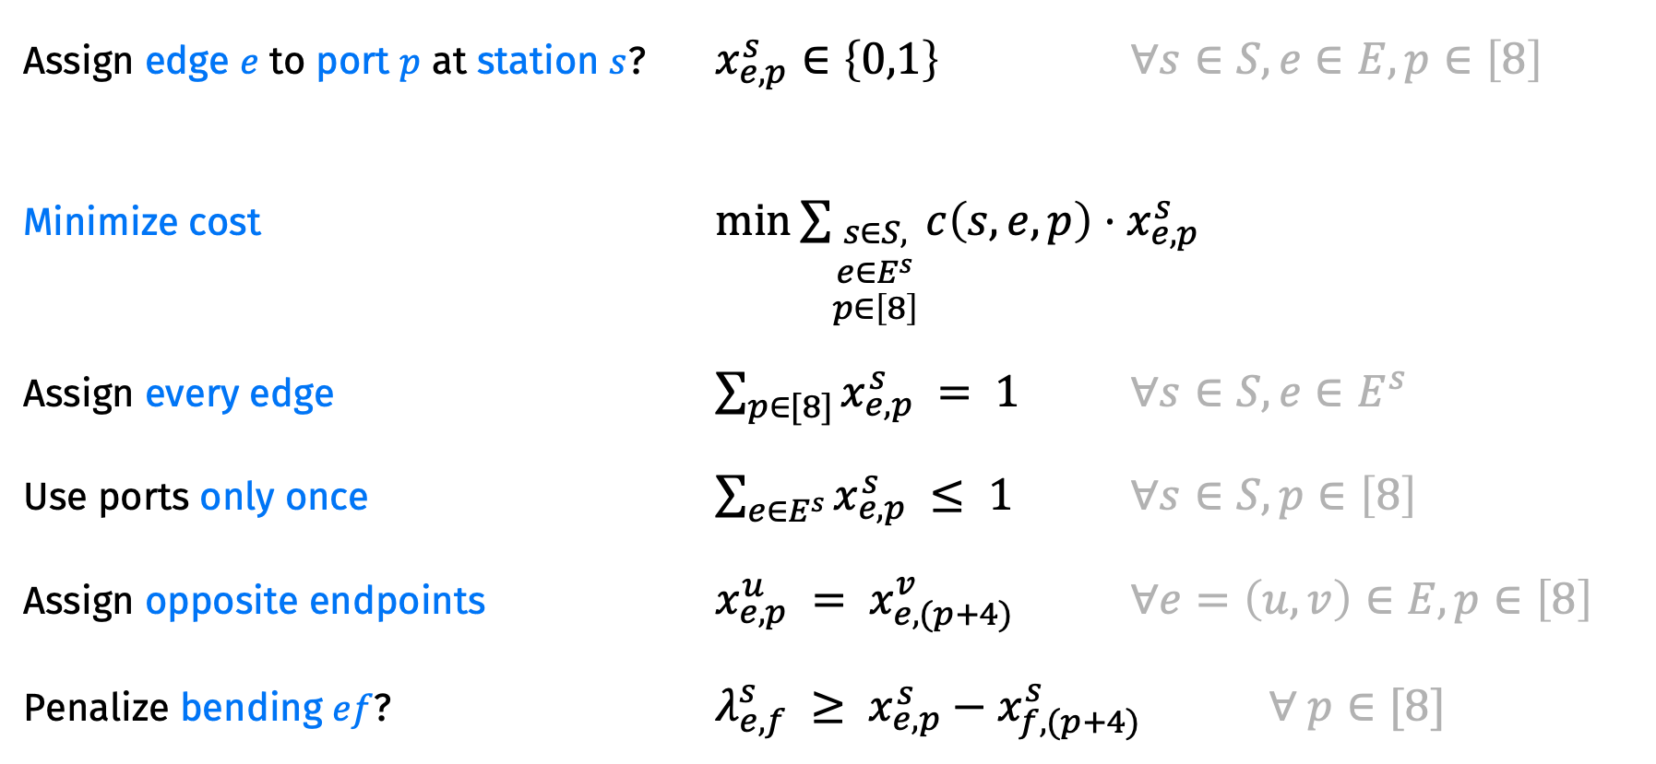
Consistent Port Assignment with bend penalty
Assign edge $e$ to port $p$ at station $s$? $x_{e,p}^{s}∈\left\{0,1\right\}$ $∀s∈S,e∈E, p∈\left[8\right]$
Minimize cost $\min{\sum_{\begin{aligned}s∈S, \\ e∈E^{s} \\ p∈\left[8\right]\end{aligned}}{c\left(s,e,p\right)⋅x_{e,p}^{s}}}$
Assign every edge $\sum_{p∈[8]}{x_{e,p}^{s}} = 1$ $∀s∈S, e∈E^{s}$
Use ports only once $\sum_{e∈E^{s}}{x_{e,p}^{s}} ≤ 1$ $∀s∈S, p∈\left[8\right]$
Assign opposite endpoints $x_{e,p}^{u} = x_{e,(p+4)}^{v}$ $∀e=\left(u,v\right)∈E, p∈\left[8\right]$
Penalize bending $ef$? $λ_{e,f}^{s} ≥ x_{e,p}^{s}−x_{f,(p+4)}^{s}$ $∀ p∈[8]$
$+ ∑ B⋅λ_{e,f}^{s}$

Slide 27
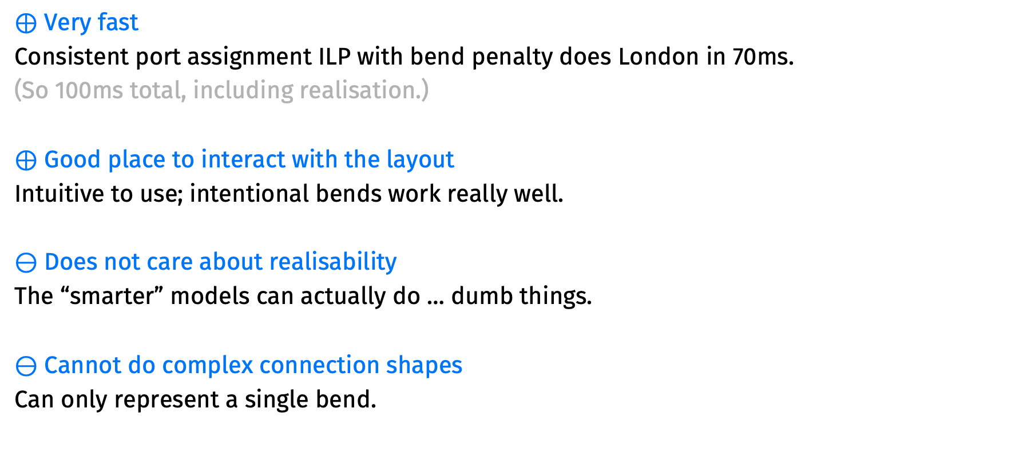
Pros & Cons: Port Assignment
$⊕$ Very fast
Consistent port assignment ILP with bend penalty does London in 70ms.
(So 100ms total, including realisation.)
$⊕$ Good place to interact with the layout
Intuitive to use; intentional bends work really well.
$⊖$ Does not care about realisability
The “smarter” models can actually do … dumb things.
$⊖$ Cannot do complex connection shapes
Can only represent a single bend.

Slide 28
Limitations of Mooey
Fixed octolinearity
Not fundamental to the algorithmics; fixed directions and straight lines are.
No labelling
We have pretty solid ideas though…
Not a real product
You can shoot yourself in the foot without a good way to recover.
Would need much more software development.
We are not going to do that(?)

Slide 29
Recap
Dis-integrate an optimisation problem and put the user in a strategic place.
We picked port assignment.
Fast algorithms on either side.
Actual implementation with effort on UX.
Interacting with it led us to some different places than we thought we were going.
Integration with Loom pipeline through matching file format.

